Slide 1
Masks as Social History
By the Alutiiq Museum

Slide 2
Video: Coming Home: The Return of the Alutiiq Masks an Earthsongs special documentary: Dmae Lo Roberts (YouTube)
https://youtu.be/VEUbSfGlPKM

Slide 3
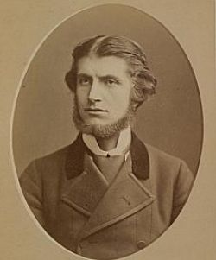
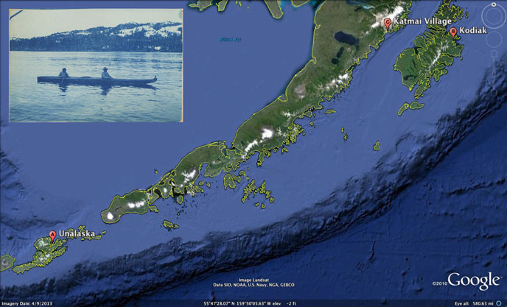
Alphonse Pinart
National Park Service: Photo of Alphonse Pinart: (Societe de Geographie) and the Map: “To travel just from Unalaska to Kodiak by air today is a distance of over 600 miles, so one can imagine how mammoth of an undertaking this was in a skin kayak in the open ocean! Map courtesy of Google Earth. Inset photo courtesy of Edwin F. Glenn papers, Archives and Special Collections, Consortium Library, University of Alaska Anchorage.” https://www.nps.gov/katm/blogs/explorers-of-katmai-country-alphonse-pinart-1852-1911.htm

Slide 5
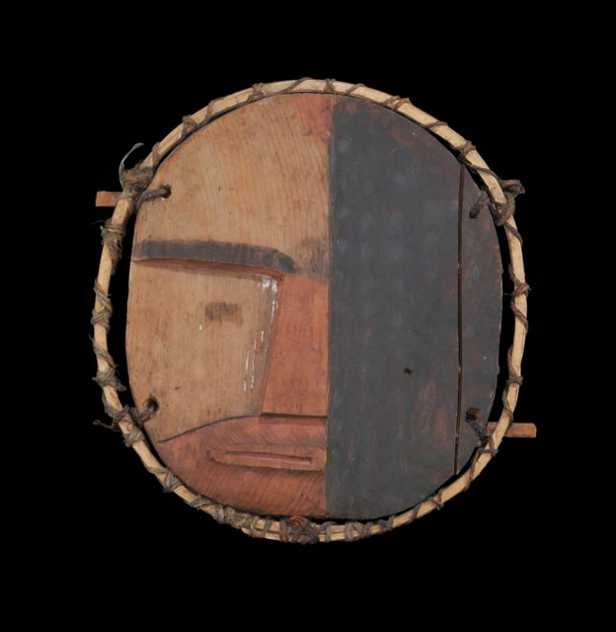
Unnuyayuk — Night Traveler
Why is it my helper spirit, why is it you are apprehensive of me?
On the seal rocks I will bring you game to be caught.
I went through the inside of the universe,
my helper, that one made me afraid.
I went down where they are motioning.
Unnuyayuk, “Night Traveler” from the Pinart Collection at the Musée de Boulogne-sur-Mer, France, ca. 1872.

Slide 6
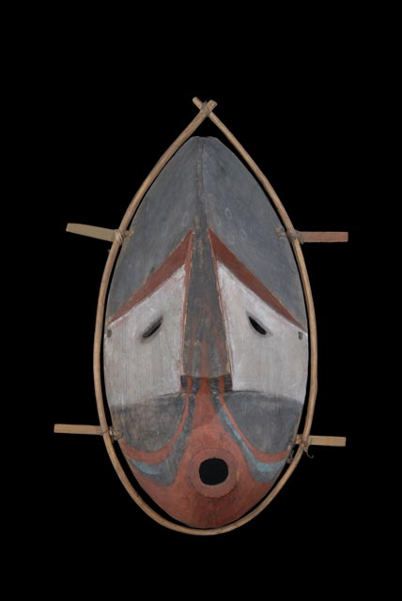

Slide 7
Chumliiq — First One
My house up there, in the Universe
up there you don’t know it.
Is it behind the sun, is it behind the one up above? (Behind that one up there the suns up there) — pik’um up there behind.
My helper, I am approaching you from
up above, I keep trying to come.
My helper, that one’s lands doesn't need
performers.
Chumliiq, “First One” from the Pinart Collection at the Musée de Boulogne-sur-Mer, France, ca. 1872.

Slide 8
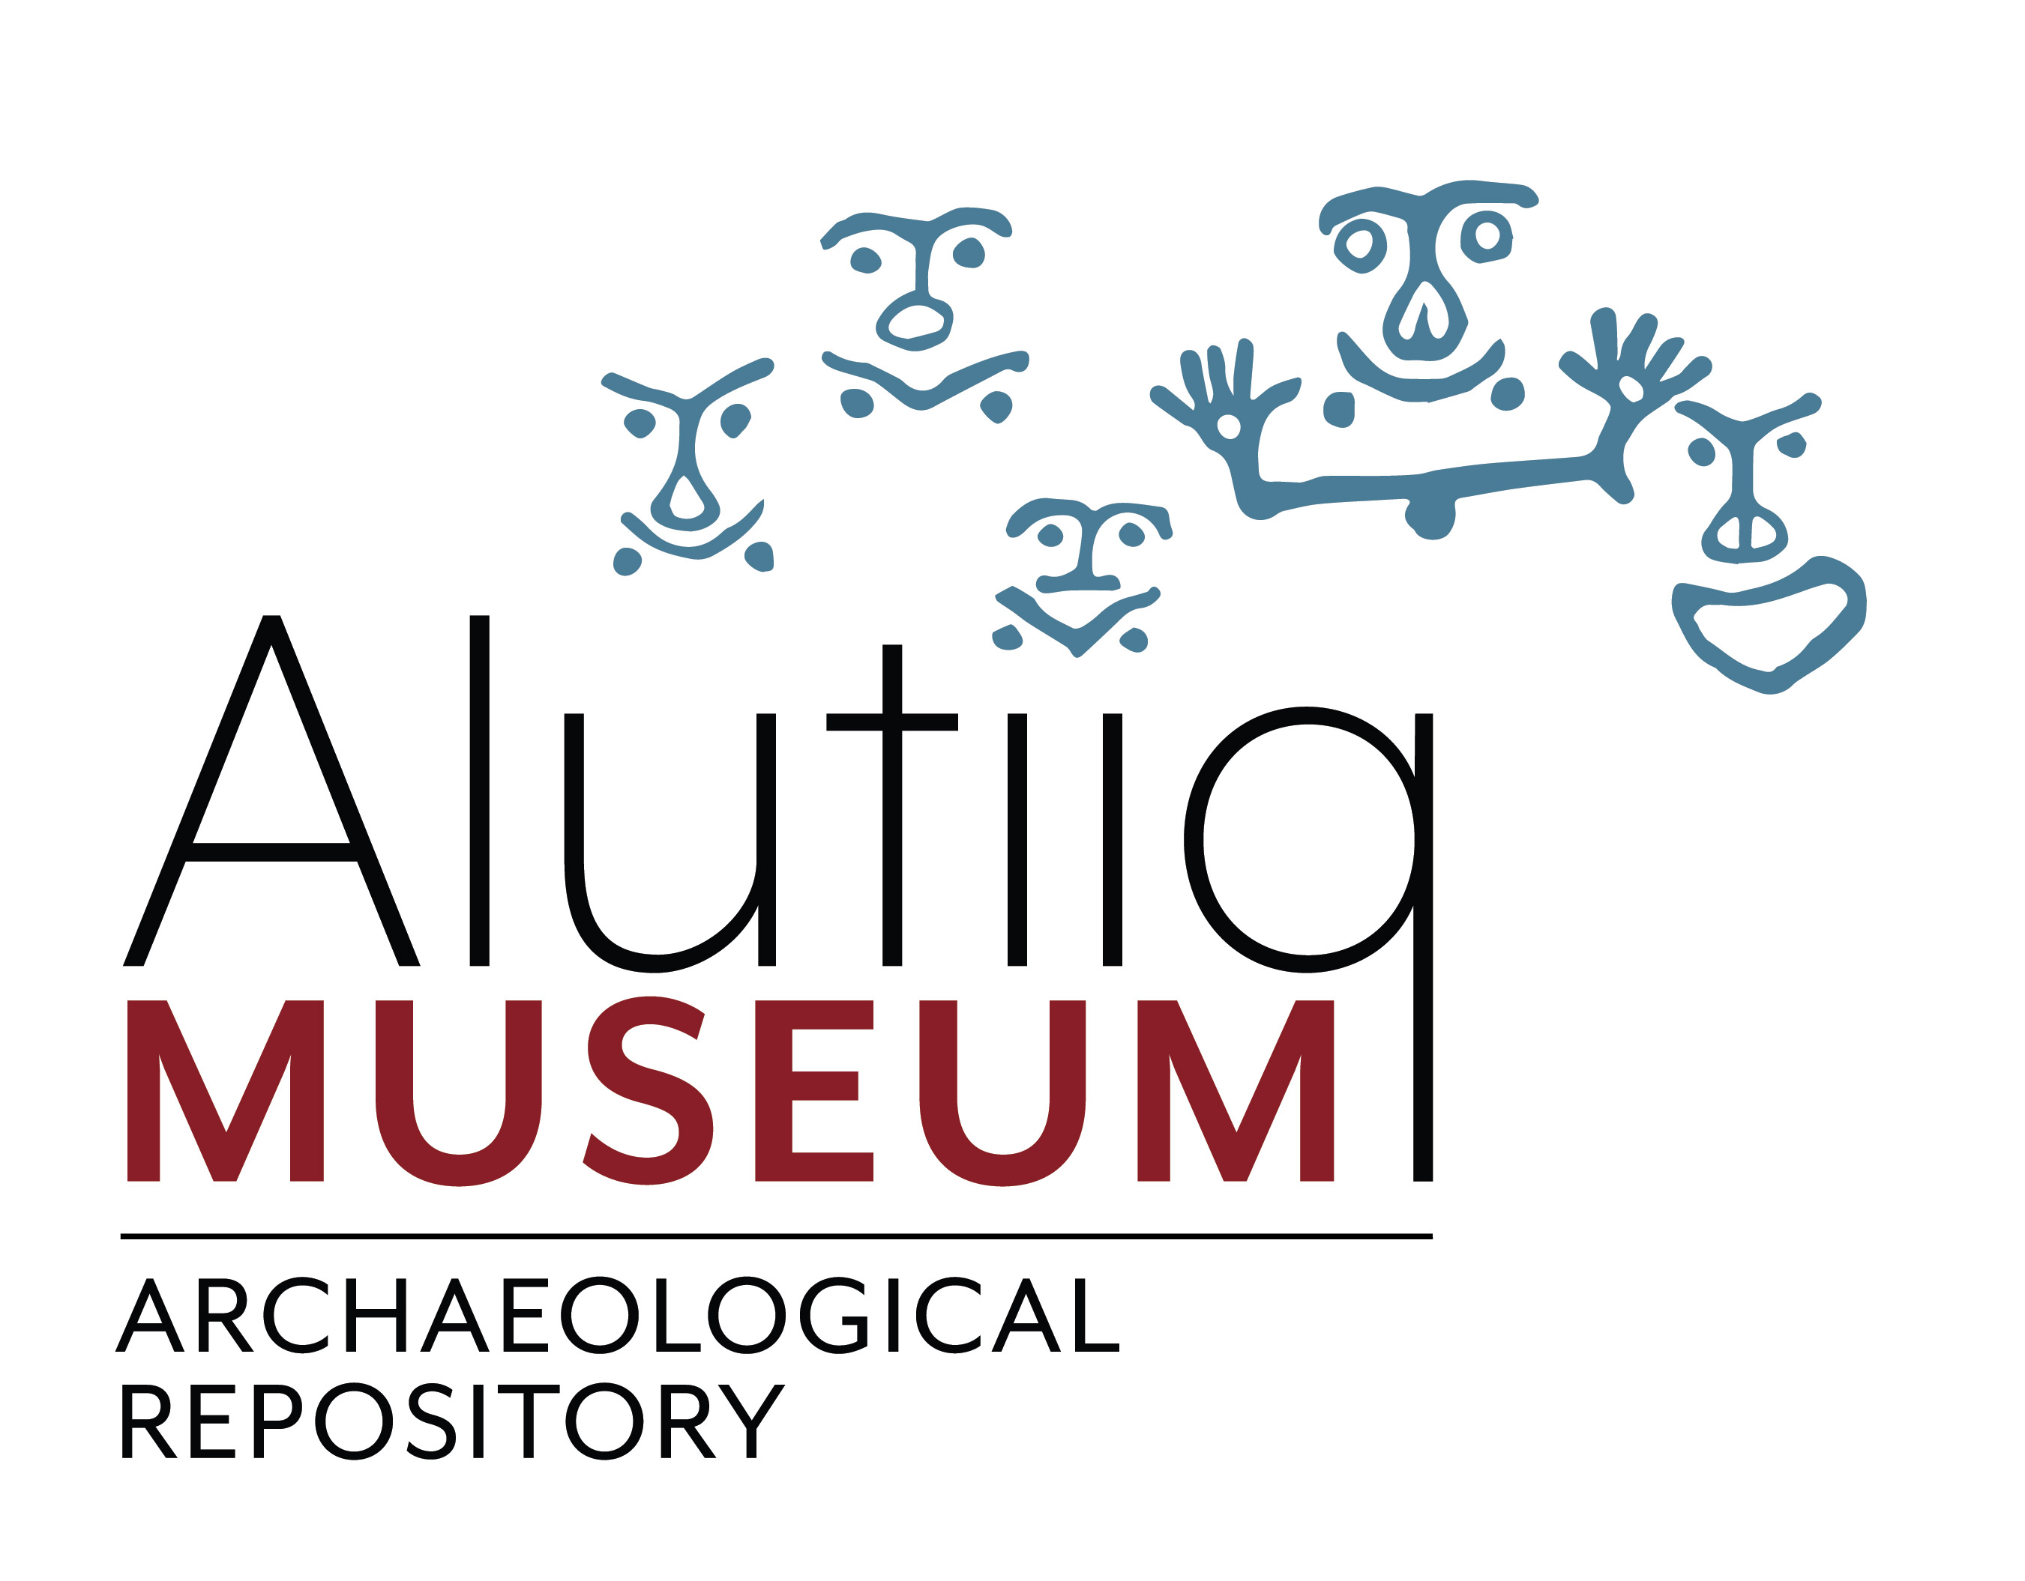
References
Haakanson, S., Jr. , & Steffian, A. (2009). Giinaquq Like a Face:
Sugpiaq Masks of the Kodiak Archipelago . Fairbanks , AK : University of Alaska Press
Coming Home: The Return of the Alutiiq Masks an Earthsongs special documentary: Dmae Lo Roberts (YouTube) https://www.youtube.com/watch?v=VEUbSfGlPKM
National Park Service : Photo of Alphonse Pinart: (Societe de Geographie) and the Map: “To travel just from Unalaska to Kodiak by air today is a distance of over 600 miles, so one can imagine how mammoth of an undertaking this was in a skin kayak in the open ocean! Map courtesy of Google Earth. Inset photo courtesy of Edwin F. Glenn papers, Archives and Special Collections, Consortium Library, University of Alaska Anchorage.” https://www.nps.gov/katm/blogs/explorers-of-katmai-country-alphonse-pinart-1852-1911.htm
Chumliiq-First One: Chumliiq, “First One” from the Pinart Collection at the Musée de Boulogne-sur-Mer, France, ca. 1872.
Unnuyayuk- Night Traveler: Unnuyayuk, “Night Traveler” from the Pinart Collection at the Musée de Boulogne-sur-Mer, France, ca. 1872.

