Slide 1
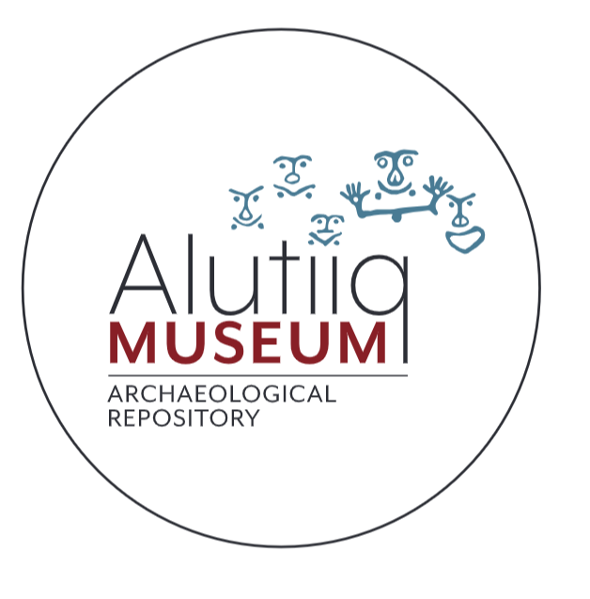
Alutiiq Petroglyphs
Alutiiq Museum & Archaeological Repository
215 Mission Rd, Suite 101, Kodiak, AK 99615 (844) 425-8844; alutiiqmuseum.org

Slide 2
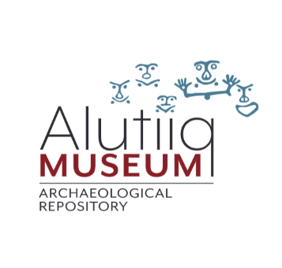
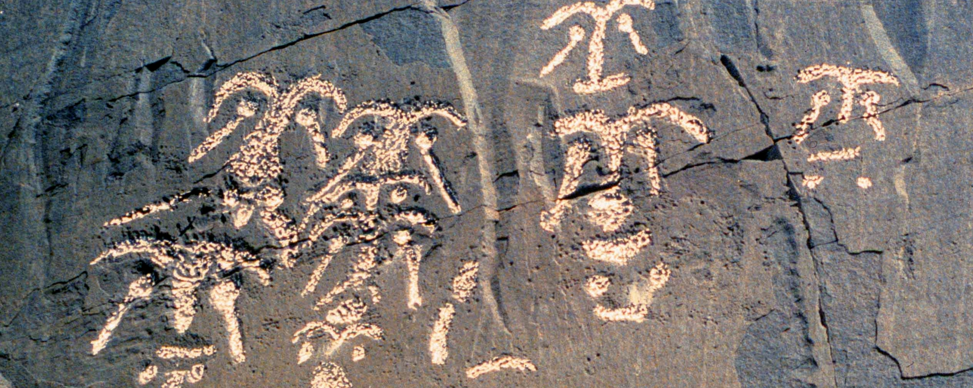
What are petroglyphs?
Petroglyphs are designs carved into boulders, cliff faces, and other stationary pieces of stone.
The word petroglyph literally translates as rock carving. It comes from the Greek petros (petra) for rock and gluphein (glyph) for carving.

Slide 3
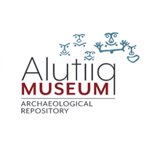
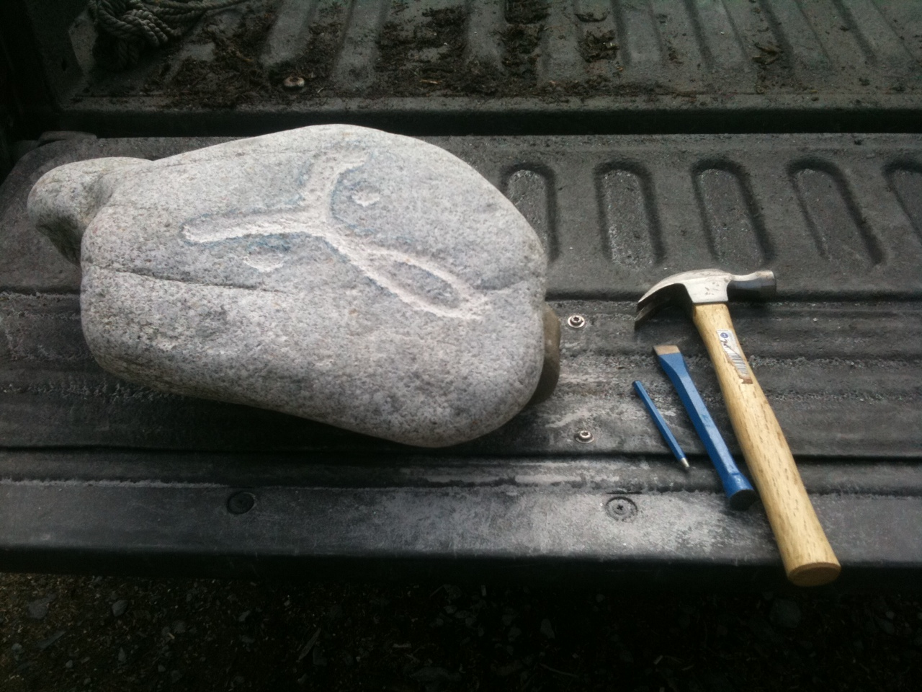
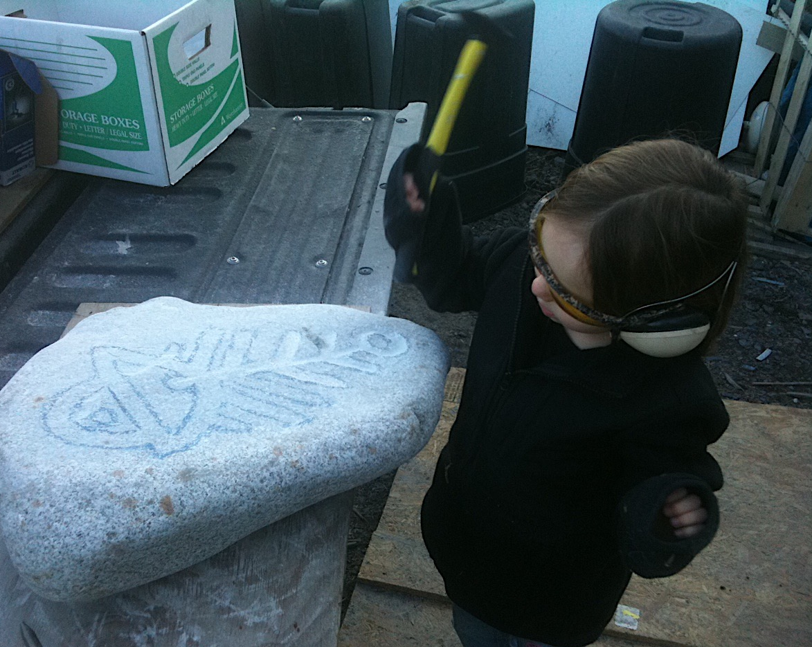
How were petroglyphs made?
Petroglyphs were made by pecking shallow impressions into the granite bedrock to create images. The craftsman would likely have pounded one rock with another to chip off small pieces of stone.
Artists created deep, clean lines and carefully formed shapes and silhouettes. Making the petroglyphs would have taken time and careful craftsmanship.
A modern Alutiiq artist has created petroglyphs on granite boulders using a chisel and hammer. You can see examples outside the Kodiak Public Library.

Slide 4
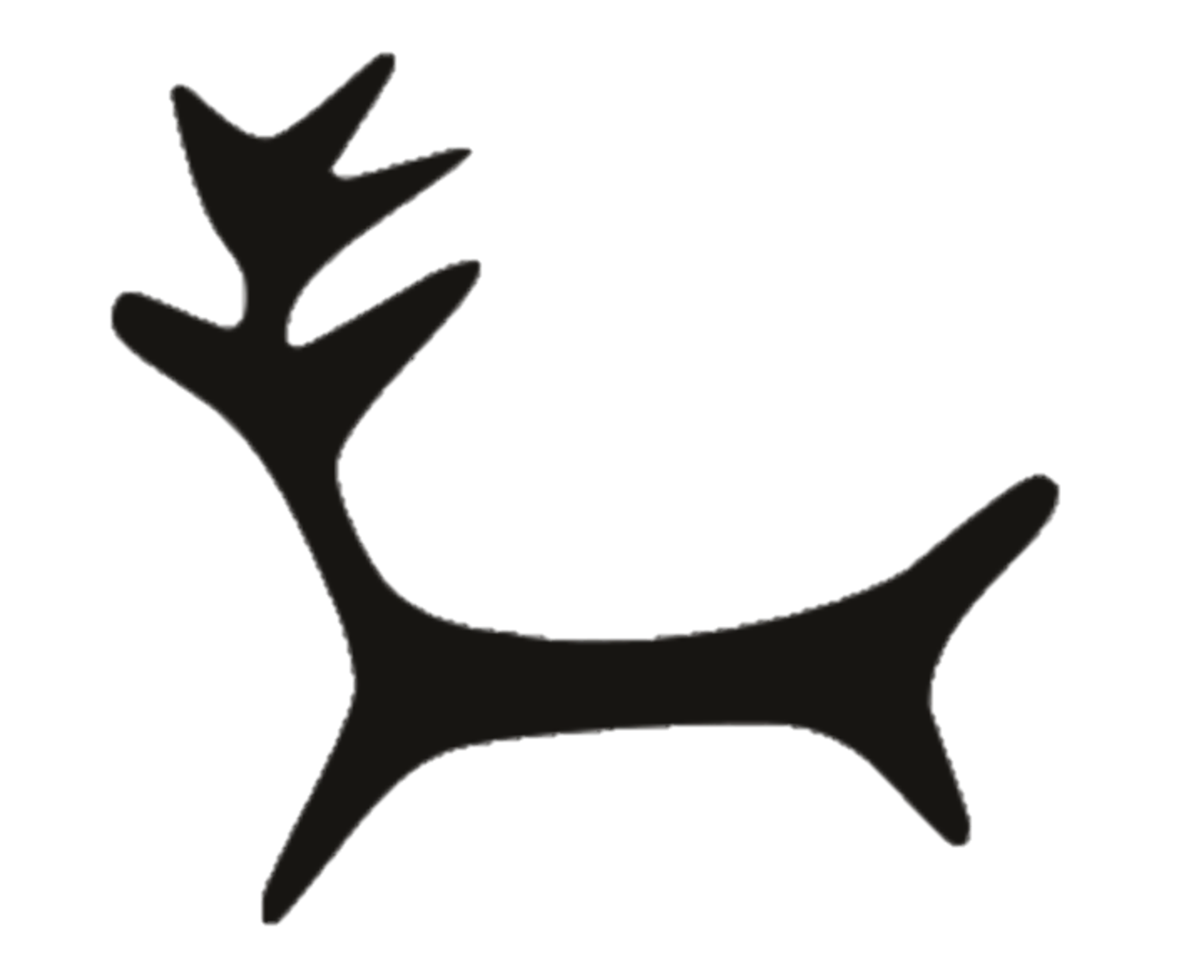
What do they mean?
The petroglyphs often depict human figures, animal forms, and geometric designs.
Some petroglyphs can tell us about Alutiiq customs. Many of the petroglyph faces have labrets (lip plugs), showing that people wore this form of jewelry.

Slide 5
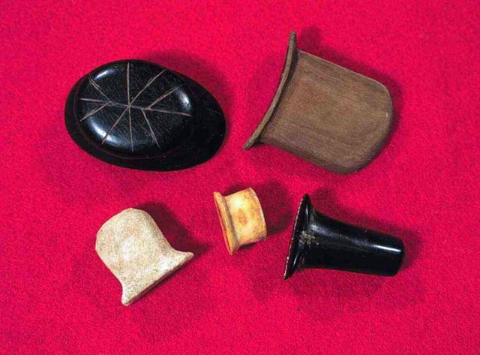
Labrets Explained
Throughout Alaska, many Native people wore labrets: decorative plugs
of bone and stone inserted through holes pierced in their cheeks and
below their lips.
Anthropologists believe that labrets acted as symbols of personal identity. High-status individuals wore large, highly decorated labrets.
Labrets first appeared in the
Kodiak Archipelago about 2,500 years ago,
at the same time that other forms
of jewelry developed. Their use continued
until the Russian era.
Many of the petroglyph faces have two
circle shapes underneath the mouth area
which symbolize the face’s labret piercings.

Slide 6
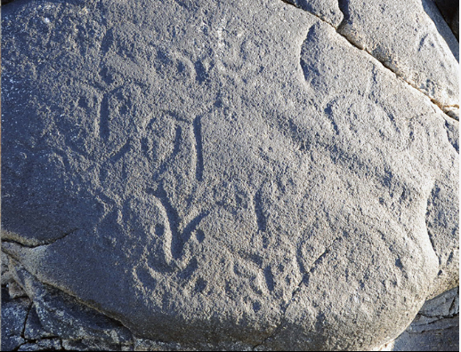
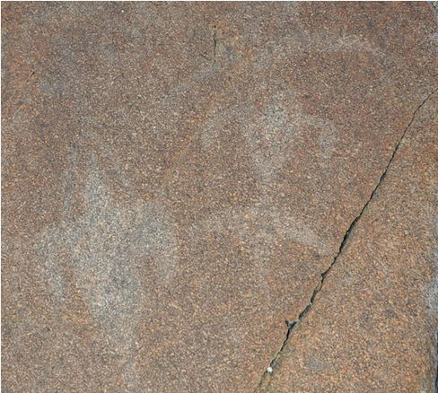
Why were Petroglyphs made?
The original function of the petroglyphs has been lost to time, but we can use clues from Alutiiq culture and the environment to hypothesize about their meaning.
Petroglyphs commonly occur at the entrances to bays, facing outward toward the open ocean. Perhaps they were markers for a family or village’s subsistence area. The faces might represent important leaders or ancestors from that area.
The images could be part of a hunting ritual. Historic accounts report that whalers carved images into rocks to bring them luck before the hunt.
Why do you think the petroglyphs were made?

Slide 7
How old are the petroglyphs?
Archaeologist do not know exactly how old the petroglyphs are. There is no easy way to date the carvings. Alutiiq elders learned from their parents that the images are very old. Archaeological finds from ancient nearby villages suggest that the petroglyphs may be about 1,000 years old!
Clues to the age of the Kodiak Petroglyphs
Clue Three: Stone
Working Traditions
Many prehistoric villages contain pecked stone artifacts made like the petroglyphs. Stone pecking was particularly popular about 1,200 years ago, when people fashioned decorated oil lamps from beach cobbles. Petroglyphs may be part of this
tradition.
Clue One: Village Sites
At Cape Alitak most of the petroglyphs occur beside old village sites. Carbon dates suggest people lived in these villages between 600 to 1,700 years ago. The Petroglyphs may be the same age.
Clue Two: Face Styles
Petroglyph faces are very similar to faces drawn on thousands of small slate pebbles about 500 years old. We don’t know what the pebbles were used for, but these common artifacts share an artistic style with the petroglyphs.

Slide 8
Cross-Cultural Comparisons of Petroglyphs
Many different cultures around the world have made petroglyphs throughout history. Spend some time researching petroglyphs from other cultures around the world.
What do these petroglyphs have in common with the Alutiiq petroglyphs on Kodiak? How are they different?
If you were to make petroglyphs, what images would you carve?

